Slide 1
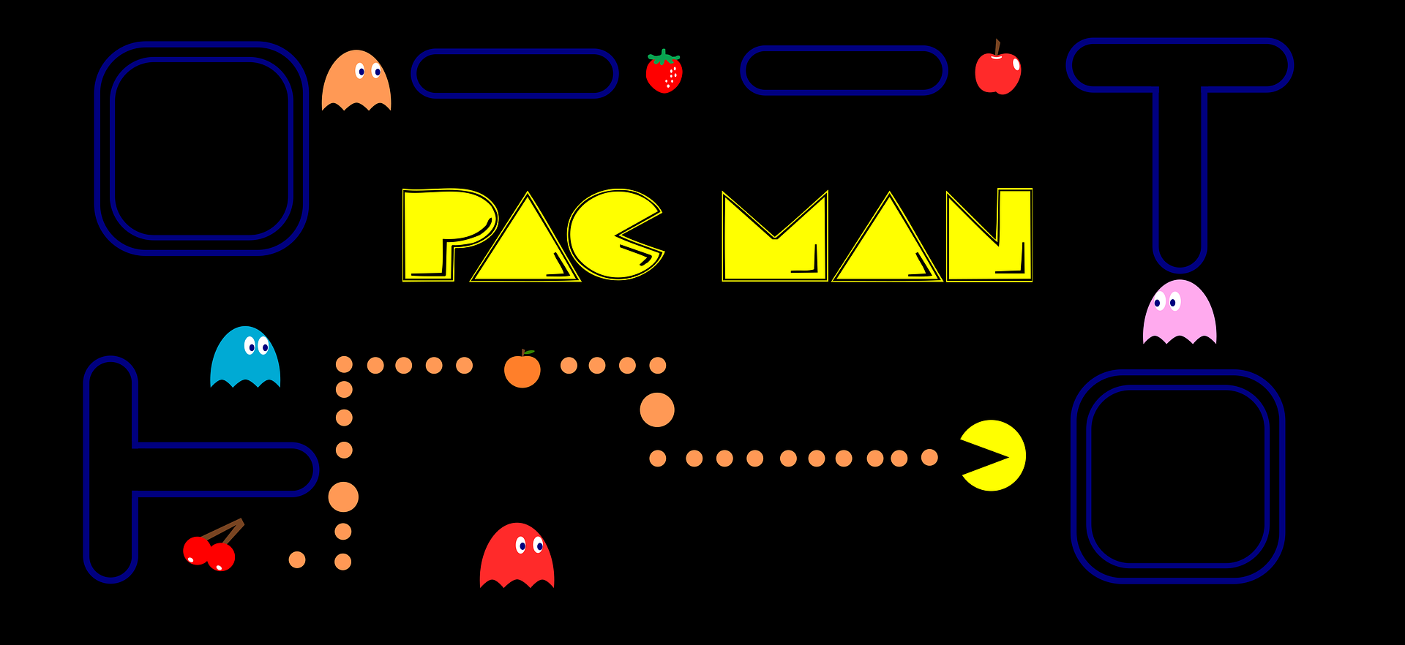
WELCOME TO MY PRESENTATION
Click to Continue
PAC-MAN – PAC-MAN – PACMAN –PACMAN - PAC-MAN – PAC-MAN – PACMAN -PACMAN
PAC-MAN – PAC-MAN – PACMAN –PACMAN - PAC-MAN – PAC-MAN – PACMAN -PACMAN

Slide 2



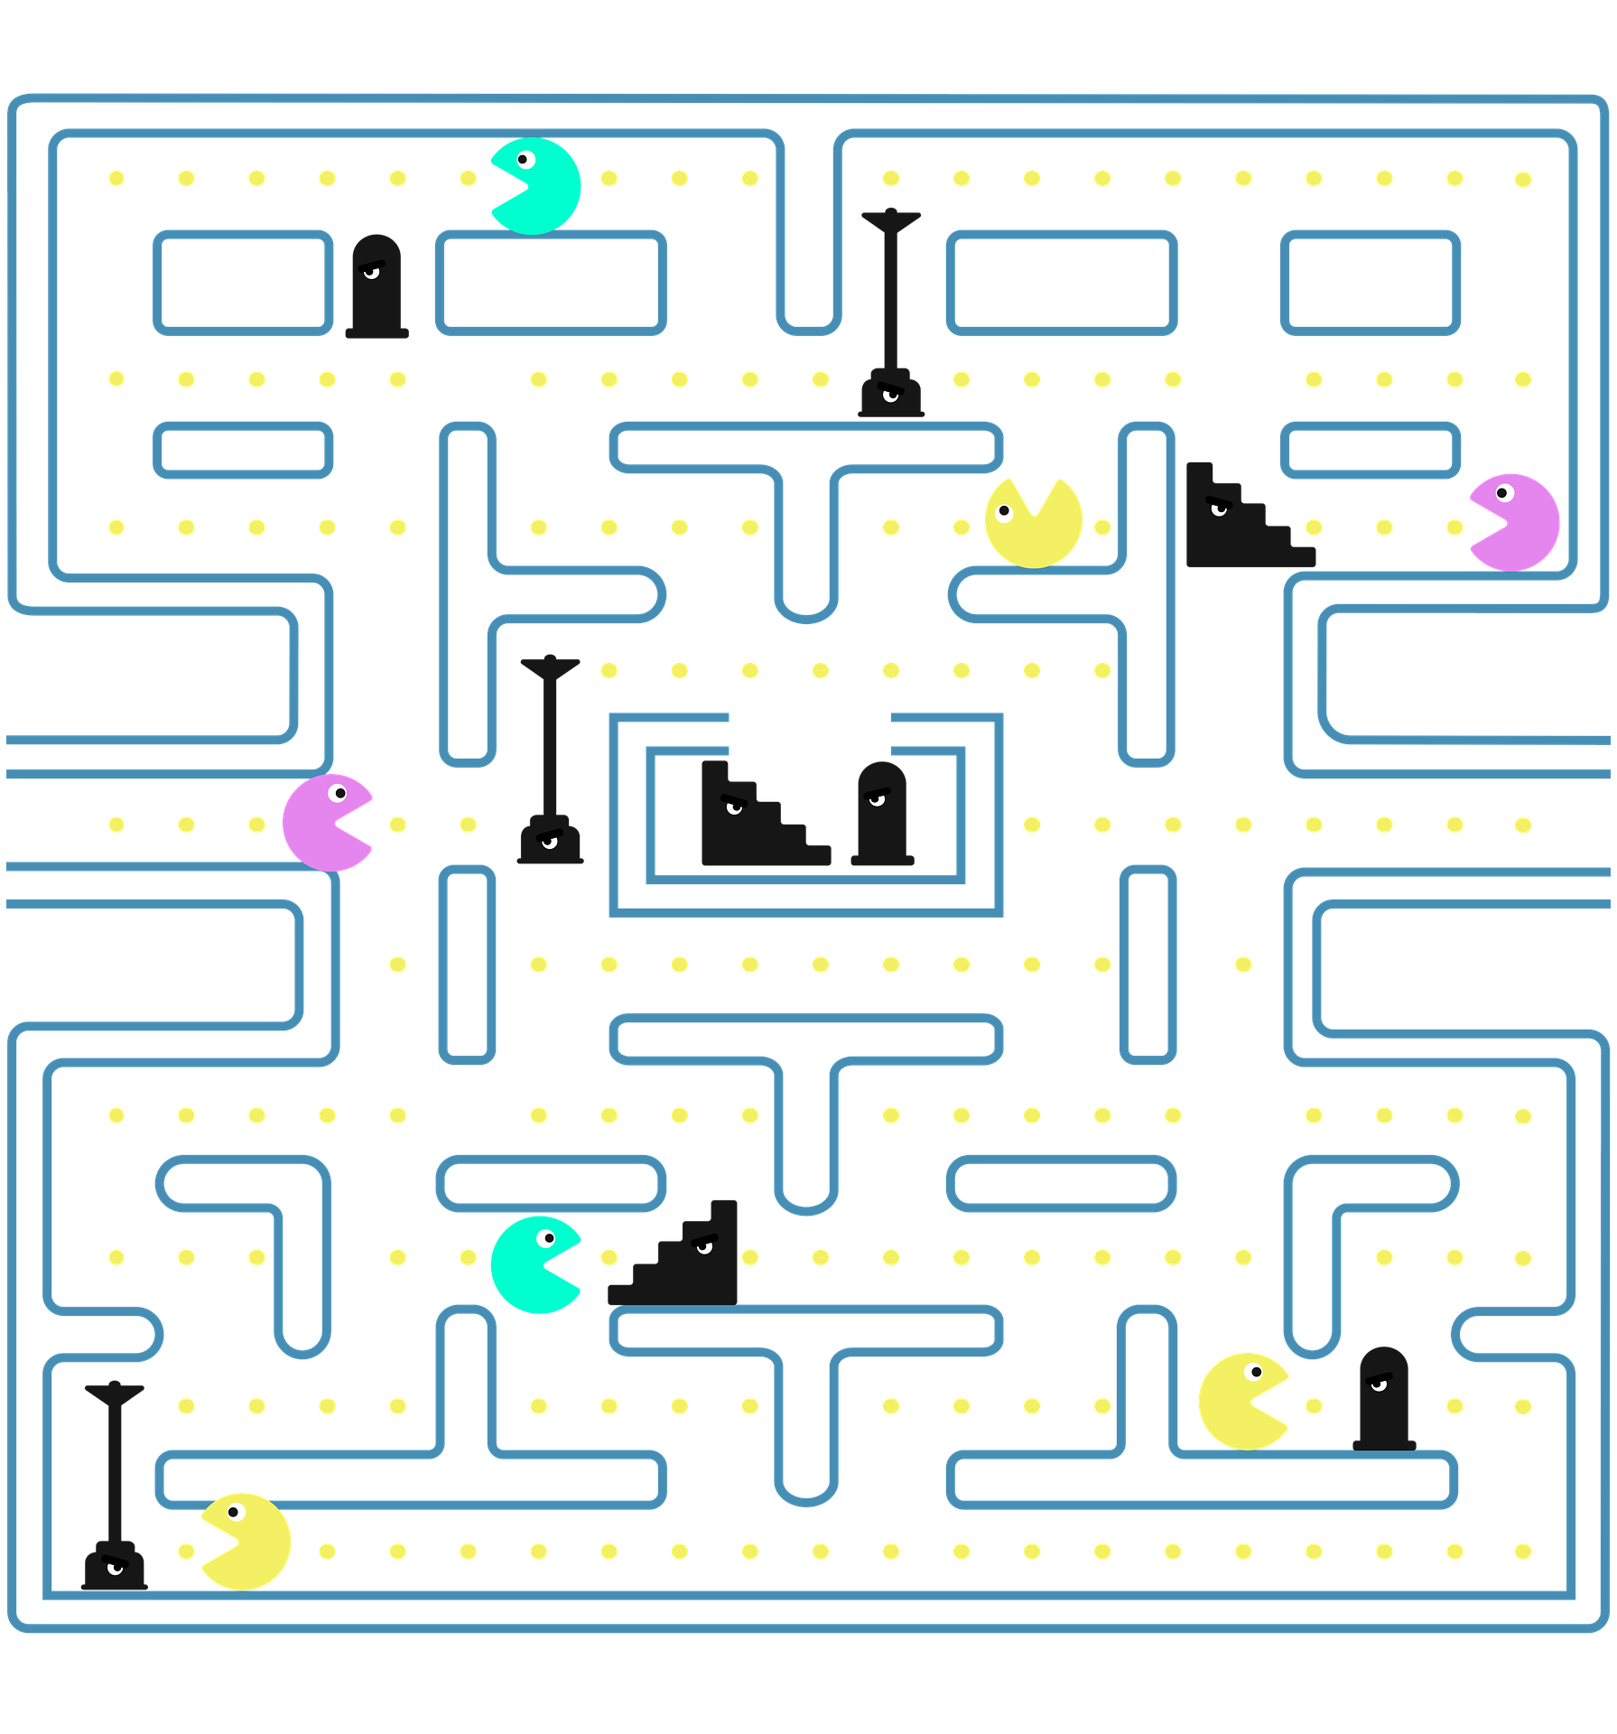
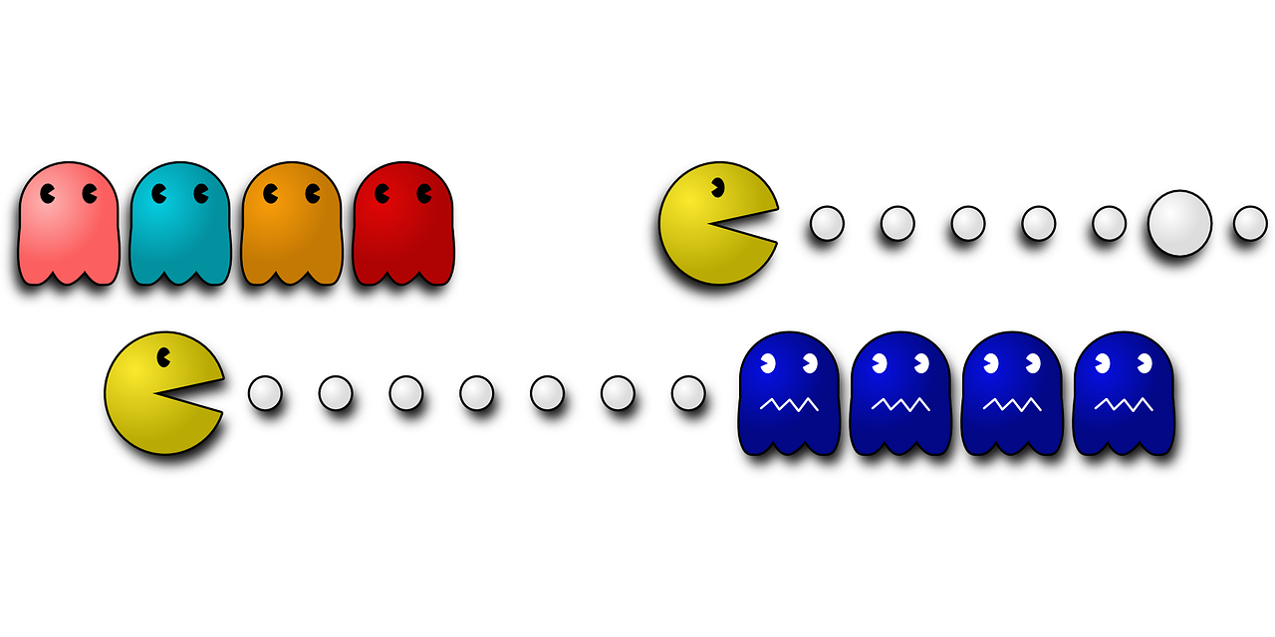
MENU
TITLE
TEAM
CONTENT
EXIT
TITLE

Slide 3
MENU
BACK
TITLE
PAC-MAN
THIS IS YOUR PRESENTATION TITLE

Slide 4



MENU
TITLE
TEAM
CONTENT
GAME
NAME
NAME
NAME
PAC-MAN – PAC-MAN – PACMAN –PACMAN - PAC-MAN – PAC-MAN – PACMAN -PACMAN
PAC-MAN – PAC-MAN – PACMAN –PACMAN - PAC-MAN – PAC-MAN – PACMAN -PACMAN

Slide 5
MENU
TITLE
TEAM
CONTENT
GAME
TABLE OF CONTEN
01
02
03
04
START
START
START
START
PAC-MAN – PAC-MAN – PACMAN –PACMAN - PAC-MAN – PAC-MAN – PACMAN -PACMAN
PAC-MAN – PAC-MAN – PACMAN –PACMAN - PAC-MAN – PAC-MAN – PACMAN -PACMAN

Slide 6
01
BACK
01
TEXT
PAC-MAN – PAC-MAN – PACMAN –PACMAN - PAC-MAN – PAC-MAN – PACMAN -PACMAN
PAC-MAN – PAC-MAN – PACMAN –PACMAN - PAC-MAN – PAC-MAN – PACMAN -PACMAN

Slide 7
02
BACK
02
TEXT
PAC-MAN – PAC-MAN – PACMAN –PACMAN - PAC-MAN – PAC-MAN – PACMAN -PACMAN
PAC-MAN – PAC-MAN – PACMAN –PACMAN - PAC-MAN – PAC-MAN – PACMAN -PACMAN

Slide 8
03
BACK
03
TEXT
PAC-MAN – PAC-MAN – PACMAN –PACMAN - PAC-MAN – PAC-MAN – PACMAN -PACMAN
PAC-MAN – PAC-MAN – PACMAN –PACMAN - PAC-MAN – PAC-MAN – PACMAN -PACMAN

Slide 9
04
BACK
04
TEXT
PAC-MAN – PAC-MAN – PACMAN –PACMAN - PAC-MAN – PAC-MAN – PACMAN -PACMAN
PAC-MAN – PAC-MAN – PACMAN –PACMAN - PAC-MAN – PAC-MAN – PACMAN -PACMAN

Slide 10
MENU
TITLE
TEAM
CONTENT
GAME
GAME

Slide 11
Click to Continue
PAC-MAN – PAC-MAN – PACMAN –PACMAN - PAC-MAN – PAC-MAN – PACMAN -PACMAN
PAC-MAN – PAC-MAN – PACMAN –PACMAN - PAC-MAN – PAC-MAN – PACMAN -PACMAN

Slide 12



YOU WIN
Khu A Click vào trái tim để xem câu hỏi
Click 1 lần để đi tiếp
10
20
30
40
50
A
YOU WIN
Khu B Click vào Chữ B để xem câu hỏi
Click 2 lần để đi tiếp
10
20
30
40
B
50

Slide 13
01
Team A Question 1
Answer
Answer
Answer
Answer
BACK

Slide 14
03
Team A Question 1
Answer
Answer
Answer
Answer
BACK

Slide 15
04
Team A Question 1
Answer
Answer
Answer
Answer
BACK

Slide 16
05
Team A Question 1
Answer
Answer
Answer
Answer
BACK

Slide 17
THANK YOU
PAC-MAN – PAC-MAN – PACMAN –PACMAN - PAC-MAN – PAC-MAN – PACMAN -PACMAN
PAC-MAN – PAC-MAN – PACMAN –PACMAN - PAC-MAN – PAC-MAN – PACMAN -PACMAN

